Slide 1
IMPACT OF MIGRATION ON GDP
Presented by: Martha, Nithya, Donicia
July 2019

Slide 2
Assumptions
The analysis was conducted using two data sources:
Data Sources:
World Bank - GDP (US$) current report (last published 2018)
United Nations Migration Data (last published 2017)
Years presented are 2005,2010,2015 and 2017.
2017 was the last year published by the United Nations.
The top 20 countries were selected using the total number of migrants from country of origination over the years selected.
Countries are categorized within the World Bank GDP data and mapped to United Nations Migration Data.

Slide 3

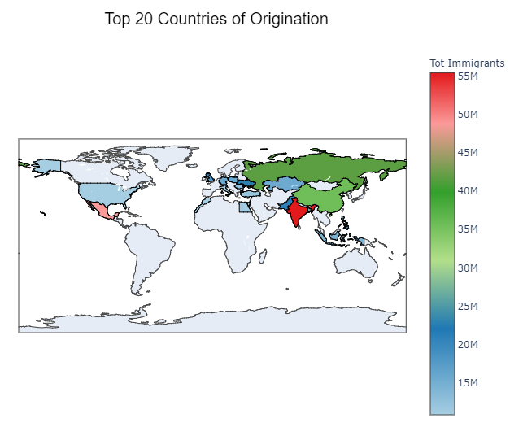
International migrant population
This dataset presents origination patterns of migration by country are presented for the years 2005, 2010, 2015 and 2017.

Slide 4

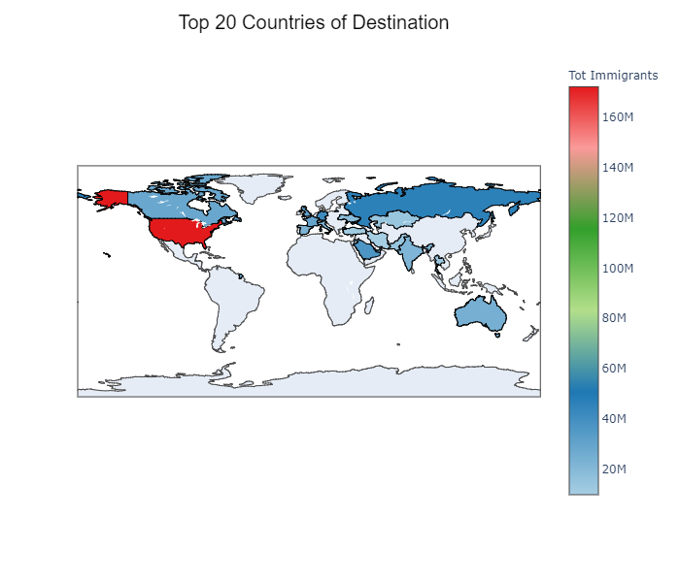
International migrant population
This dataset presents estimates of international migrant population by the top 20 destinations.

Slide 5
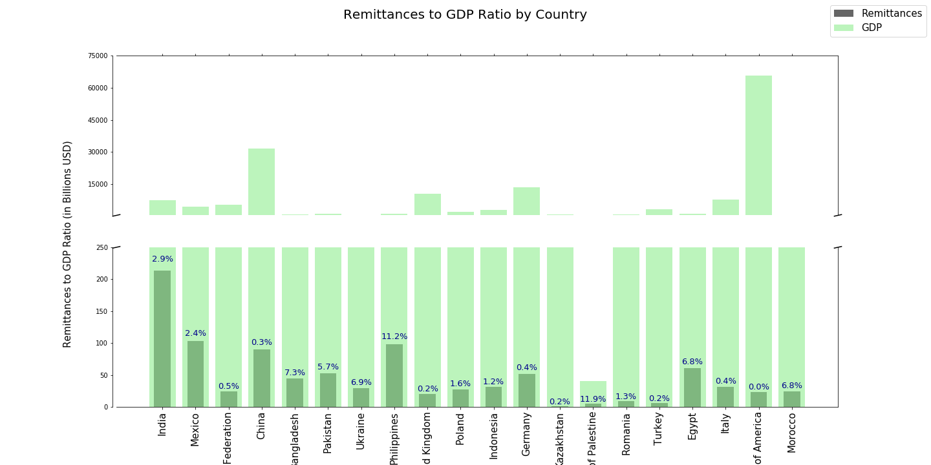
PERSONAL REMITTANCES TO GDP RATIO BY COUNTRY

Slide 6
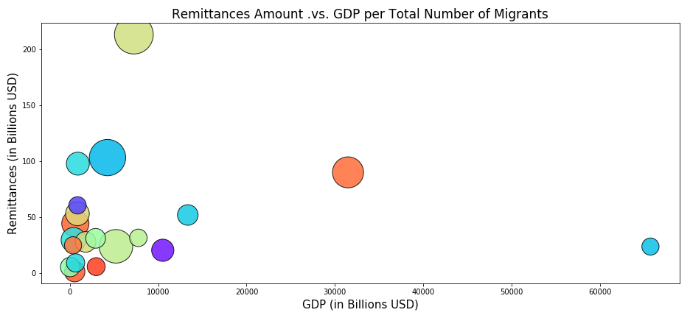
REMITTANCES AMOUNT VS GDP PER TOTAL NUMBER OF MIGRANTS
India
Mexico
TBF
TBF
United States

Slide 7
Remittances of low-income countries and migration ratio
Low Income
Lower Middle Income
India
Pakistan
Upper Middle
Income
United Kingdom
Poland
High Income
Mexico
Germany
Italy
United States of America
Bangladesh
Ukraine
Philippines
Indonesia
State of Palestine
Egypt
Morocco
Russian Federation
China
Kazakhstan
Romania
Turkey

Slide 8
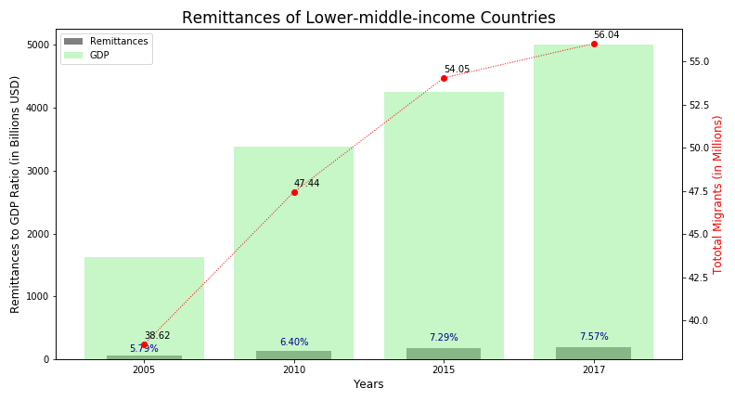
Remittances of low-middle income countries and migration ratio
This dataset presents remittances to GDP ratio and the migrant flow for the lower middle income countries over a period of 12 years.

Slide 9
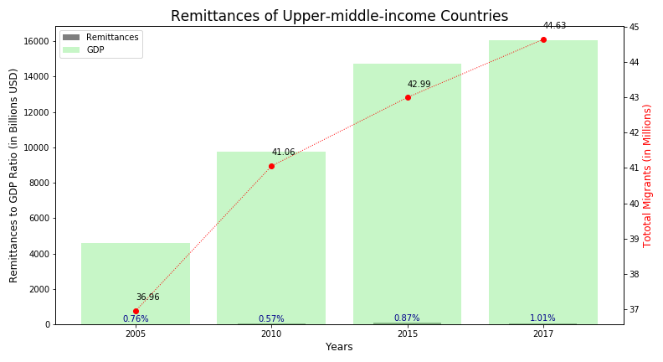
Remittances of upper-middle income countries and migration ratio
This dataset presents remittances to GDP ratio and the migrant flow for the upper middle income countries over a period of 12 years.

Slide 10
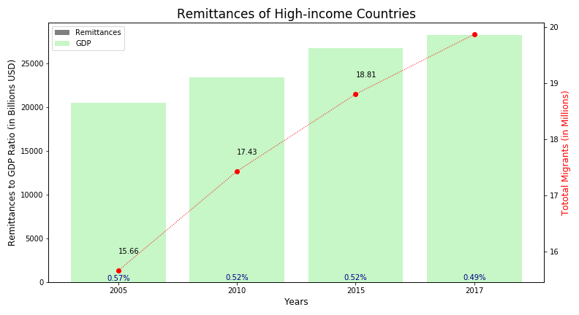
Remittances of high income countries and migration ratio
This dataset presents remittances to GDP ratio and the migrant flow for the high income countries over a period of 12 years.

Slide 11
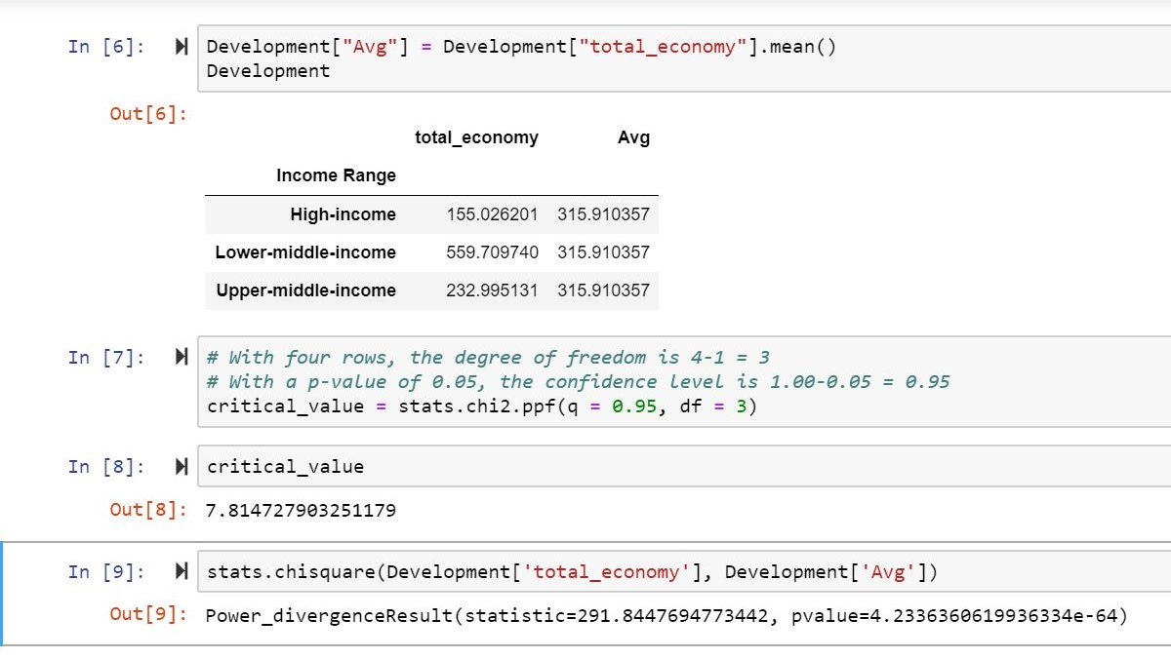
CHI SQUARE TEST
Is there a relationship between income of a country and the personal remittances received?
Null hypothesis - Regardless of income level they will send the same amount of remittances back.
P-value is a low value
The null hypothesis is False. The income level of origination countries really affects the amount of money sent back.

Slide 12
CONCLUSION
Direct co-relation – not all countries are the same.
Sub categories – low income countries are sending remittances back home but not other categories.
Helping economy in the origination countries

Slide 13
Technical aspects

Slide 14


Slide 15
THANK YOU

